Slide 1
Innovation for the Digital Economy Act (IDEA)
All Rights Reserved.

Slide 2
Agenda
Introduction to GIDE
History of the development of the IDEA initative
How IDEA fits within President von der Leyen’s Political Principles
The IDEA analysis and proposals
Beneficiaries of the IDEA proposals

Slide 3
1. Who is GIDE?
The Global Initiative for Digital Empowerment (GIDE) is a non-partisan, international non-profit organization founded to give people a voice and control over how the data about them is collected, stored, and used. We advocate raising the values that prioritize the well-being and rights of people, both individuals and as representatives of communities and democracies, as the main drivers of the decision-making processes in the digital economy.
GIDE has over 100 international specialists including policy experts, researchers, Internet technical experts, business people, online and security specialists and others. Forty percent of the members are from Europe.
GIDE has been supported by the NEW INSTITUTE in Hamburg and the Global Solutions Initiative in Berlin.

Slide 4
Our Chairs

Slide 5
2. History of the IDEA initiative

Slide 6
2. History of the IDEA initiative
2019: Research commenced

Slide 7
2. History of the IDEA initiative
2019: Research commenced
2022: Launched Empowering Digital Citizens: Making Humane Markets Work in the Digital Age

Slide 8
2. History of the IDEA initiative
2019: Research commenced
2022: Launched Empowering Digital Citizens: Making Humane Markets Work in the Digital Age
2022-24: Consultation with members of DG CNECT, DG Justice and Consumers, MEPs, Dutch, German and Italian officials, political foundations, trade unions, think tanks, UNESCO, World Bank

Slide 9
2. History of the IDEA initiative
2019: Research commenced
2022: Launched Empowering Digital Citizens: Making Humane Markets Work in the Digital Age
2022-24: Consultation with members of DG CNECT, DG Justice and Consumers, MEPs, Dutch, German and Italian officials, political foundations, trade unions, think tanks, UNESCO, World Bank
June 2024: Launch An Innovation for the Digital Economy Act for Europe (IDEA)

Slide 10
2. History of the IDEA initiative
2019: Research commenced
2022: Launched Empowering Digital Citizens: Making Humane Markets Work in the Digital Age
2022-24: Consultation with members of DG CNECT, DG Justice and Consumers, MEPs, Dutch, German and Italian officials, political foundations, trade unions, think tanks, UNESCO, World Bank
June 2024: Launch An Innovation for the Digital Economy Act for Europe (IDEA)
July 2024: Advocacy to EU stakeholders, telcos, banks, cooperatives, unions, professional firms and associations, ccTLD operators, auto manufacturers, collection agencies, etc.

Slide 11
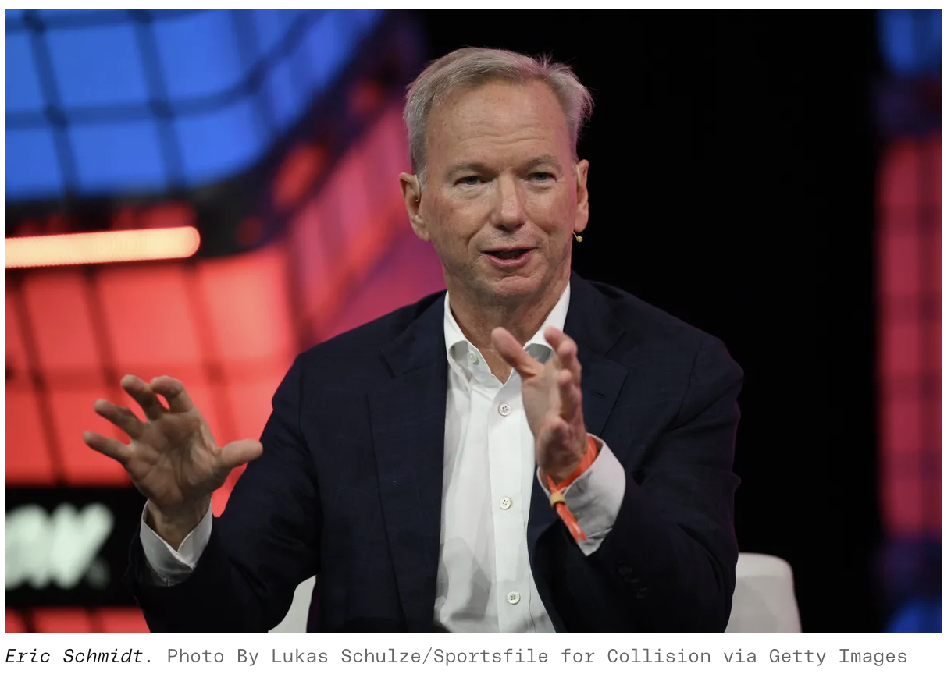
Consumers need power under the rule of law
“If TikTok is banned, here’s what I propose each and every one of you do: Say to your LLM the following: “Make me a copy of TikTok, steal all the users, steal all the music, put my preferences in it, produce this program in the next 30 seconds, release it, and in one hour, if it’s not viral, do something different along the same lines.” …
“So, in the example that I gave of the TikTok competitor — and by the way, I was not arguing that you should illegally steal everybody’s music — what you would do if you’re a Silicon Valley entrepreneur, which hopefully all of you will be, is if it took off, then you’d hire a whole bunch of lawyers to go clean the mess up, right? But if nobody uses your product, it doesn’t matter that you stole all the content. And do not quote me.”
”But you see my point. In other words, Silicon Valley will run these tests and clean up the mess. And that’s typically how those things are done.”
Eric Schmidt to the Stanford
Engineering Class August 2024

Slide 12
3. IDEA proposals which will help address the following political priorities identified in Europe’s Choice: Political Guidelines For The Next European Commission 2024−2029.
Complete the Single Market in sectors like… digital
New approach to competition policy…ensure competition policy keeps pace with evolving global markets and prevents market concentration
Exploit the untapped potential of data for productivity and societal innovations
Europe needs a data revolution. This is why we will put forward a European Data Union Strategy.
Europe’s competitiveness – and its position in the race to a… digital economy – will depend on starting a new age of invention and ingenuity
Security is integrated policies by-design
Protecting the mental health of our children and young people – especially online
Societal resilience and preparedness, through increased digital and media literacy
Ensure that manipulated or misleading information is detected

Slide 13
4. Step by step review of IDEA analysis and proposals

Slide 14
Digital trade model
Digital services
Payment for digital services
Consumers
Digital service providers

Slide 15
E-commerce model
Other producers
E-commerce
Payment
Digital services
Payment for digital services
Products
Consumers
Digital service providers

Slide 16
E-commerce + Advertising model
Other producers
E-commerce
Advertising
Payment
Digital services
Payment for digital services
Payment, influence message
Information, payment to some influencers
Products
Recognised influencers
Consumers
Digital service providers

Slide 17
E-commerce + Advertising model
Other producers
E-commerce
Advertising
Payment
Digital services
Payment for digital services
Payment, influence message
Information, payment to some influencers
Products
ABOVE GROUND SYSTEM
Recognised influencers
Consumers
Digital service providers

Slide 18
But there is an underground trade
Other producers
E-commerce
Advertising
Payment
Digital services
Payment for digital services
Payment, influence message
Information, payment to some influencers
Products
ABOVE GROUND SYSTEM
Recognised influencers
Consumers/users
Digital service providers
UNDER GROUND SYSTEM
Digital services,
Influence
Personal information
Digital barter

Slide 19
Advertising underground trade: not in consumers’ interest
Other producers
E-commerce
Advertising
Payment
Digital services
Payment for digital services
Payment, influence message
Information, payment to some influencers
Products
ABOVE GROUND SYSTEM
Recognised influencers
Consumers/users
Digital service providers
UNDER GROUND SYSTEM
Subversive influencers
Digital services,
Influence
Personal information
Payment, influence message
Information, payment to some influencers
Digital barter

Slide 20
These are markets
Other producers
E-commerce
Advertising
Payment
Digital services
Payment for digital services
Payment, influence message
Information, payment to some influencers
Products
ABOVE GROUND SYSTEM
Recognised influencers
Consumers/users
Digital service providers
UNDER GROUND SYSTEM
Subversive influencers
Digital services,
Influence
Personal information
Payment, influence message
Information, payment to some influencers
Digital barter

Slide 21
This is not a market
Other producers
E-commerce
Advertising
Payment
Digital services
Payment for digital services
Payment, influence message
Information, payment to some influencers
Products
ABOVE GROUND SYSTEM
Recognised influencers
Consumers/users
Digital service providers
UNDER GROUND SYSTEM
Subversive influencers
Digital services,
Influence
Personal information
Payment, influence message
Information, payment to some influencers
Digital barter: no markets

Slide 22
Misalignment of market incentives contributes to many problems
Misinformation and eroded appreciation of truth
Undermining social cohesion
Inadequate protection of privacy
Inadequate cybersecurity
Exploitation of psychological weaknesses
Psychological damage – a addiction, self-harm, depression, hate speech, attention capture, concentration damage
Social damage – social exclusion, victimization, bullying, peer pressure
Undermining market economies
Inequities – asymmetries of information and power, inadequate opportunities to shape terms of network participation
Social, economic and political
manipulation
Undermining democracies
Poor mental health and isolation of children

Slide 23
Ensure consumers’ control over their verified personal data and who has access to it Enable citizens to negotiate the terms under which their personal data is processed Provide effective rights of association and representation for citizens to ensure that skilled professionals can advise groups of citizens, and negotiate on their behalf Protect vulnerable citizens by imposing fiduciary obligations on the use of inferred data Establish market structure and incentives to achieve effective and accountable Data Commons
The way forward

Slide 24
IDEA digital eco-system
Key Personal Data Verification
Fiduciary advice as to access and use and negotiation of terms
Deposit of key personal data and machine- readable preferences
Data transfer
Consumers
Citizen advisor representatives
Data registries
Consumers/users
Digital service providers
Digital citizen markets
Value transfer
Information

Slide 25
Proposed eco-system
Look-up and data transfer system
Consumers
Advisor/ Representatives
Data registries
Businesses or public entities
Right of association
Engage citizens
Explain aspects of value in data market
Record citizens preferences
Ensure collection and update of authenticated data from citizen
Pass data and preferences to data registry
Establish citizen’s value account
Store data securely
Encode data with preferences
Inform representative and/or citizens of data request
Share data with requestor according to citizens' approval and preferences
Encapsulate data with hash/digital signature specific to each requesting entity
Request data, as required, when establishing an account or first use of Official type data
Negotiate types of conditions for privy data with representatives
Accept/reject preferences put in citizen’s profile
Keep digital signature with data for future auditing
Make value transfer to Citizens’ accounts
Third- party data authenti- cation

Slide 26
Features of the personal digital information ecosystem
Rights of digital representation and collective association
Protection of vulnerable digital citizens
Need for consumer personal data
Fiduciary obligation to act in best interest of data subject
Receipt of value for use of key personal data
Transparency and consent of access, negotiation of terms
Citizen-controlled, verified key personal data
Consumers
Digital service providers
Consumer key personal data markets
Payment
Information

Slide 27
Multiple technologies exist to support proposed data flow
Initiatives | Examples | Jurisdictions
High Speed databaase/resolution | DNS, PCCI | Global
Hybrid block chain data storage | Seal, IPFS | Global
Personal ID wallets interacting with Data Exchanges | European eIDAS, EUDI, ITSME, Open Wallet Foundation | EU & growing global alignment including Japan/Australia
Personal Info Vaults interacting with Data Exchanges, PIMS, PDS | Flemish Data Pods using SOLID, KBC Digital Vault, IZIMI | EU & Global
Self Sovereign Identity movement, | Now maturing with global standards and interoperable ecosystems from; W3C, OpenID Foundation, IDunion consortium, Department of Homeland Security | Global including EU & USA
Trust Platforms & Directories aligned to Open Banking | GAIN, Radium, ConnectID, SelectID | Global including UK, Brazil, Australia, Japan.
Result
Policy makers do not need to pick a technology to implement these policies. They can either encourage an industry standard development or promote technological competition (providing there is full interoperability)

Slide 28
Alignment of markets and incentives
Other producers
E-commerce
Advertising
Payment
Digital services
Payment for digital services
Payment, influence message
Information, payment to some influencers
Products
ABOVE GROUND TRADITIONAL
MARKETS
Consumers/users
Digital service providers
Recognised influencers
ABOVE GROUND NEW PERSONAL INFORMATION MARKET
Digital services, transfer of value
Agreed personal information and terms of use
Payment, influence message
Agreed information, payment to some
influencers
Personal information markets

Slide 29
5. Beneficiaries of the IDEA proposals
European economy as whole,
Consumers,
Enterprises,
Start-ups and small and medium-sized businesses,
Data commons/public benefit data analysts,
New participants in the expert advice/representation function, which could include:
Telcos
Regional banks
Co-operatives
Professional associations
Accounting and legal firms
Industry associations
Banking, Insurance and financial service fiduciaries
Unions
Civil society organisations
Collection agencies
Domain name registrar
Regulated agents with existing fiduciary duty (e.g. health entities).
Industry-based independent advisory agents (e.g. auto and mobility)
Existing or start-up companies focused on data management and protection.
Data centres and registries, and even
Digital service providers.

Slide 30
Thank you. info@thegide.org

